Slide 1

THE FIRST
OPIUM WAR
By-
Anubha Upadhyay

Slide 2
WHAT IS OPIUM?
Papaver somniferum
Addictive Drug: from Juice of opium poppy
Reddish Brown, heavy scented.
Used as a narcotic and occasionally in medicine.

Slide 3
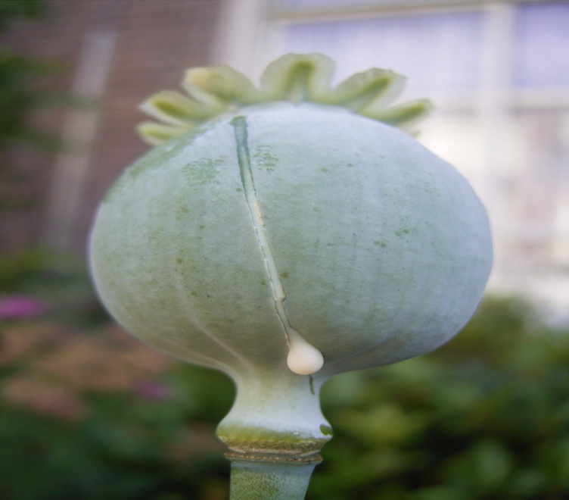
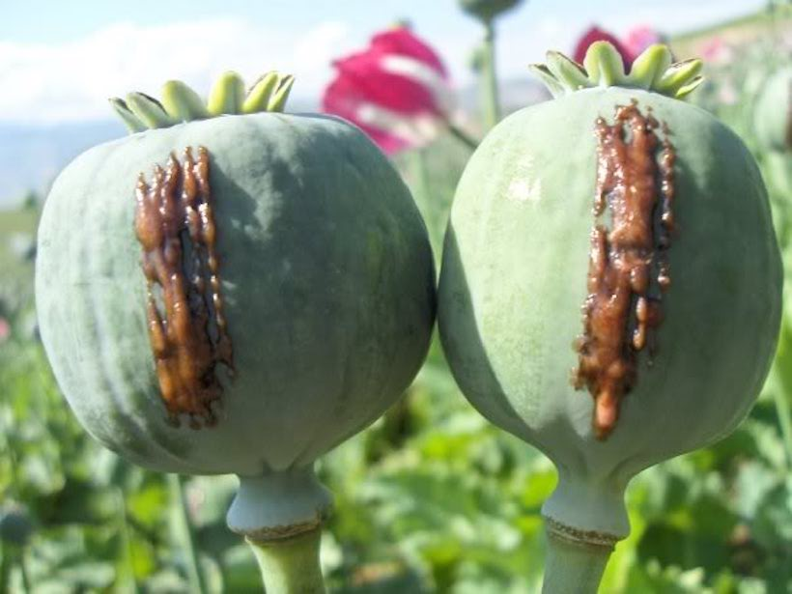
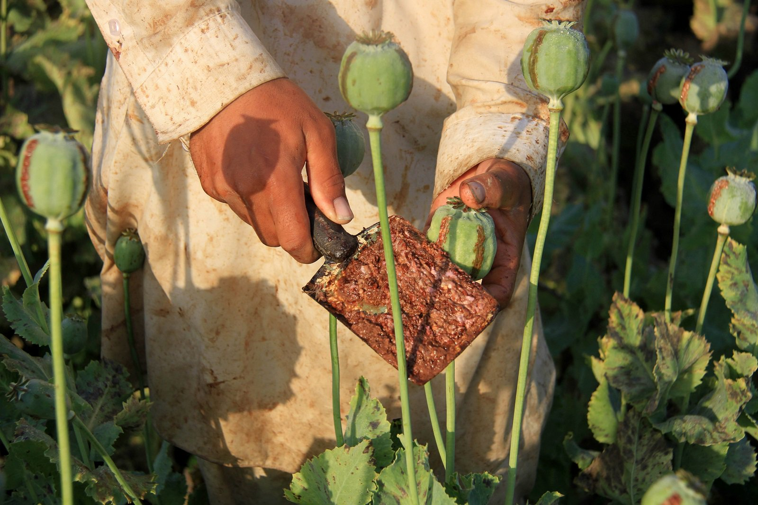
Slit
After few hours
Collected
Sources: http://www.howtokickheroin.com/wp-content/uploads/2017/01/Oxidized-poppy-latex-aka-raw-opium.jpg

Slide 4
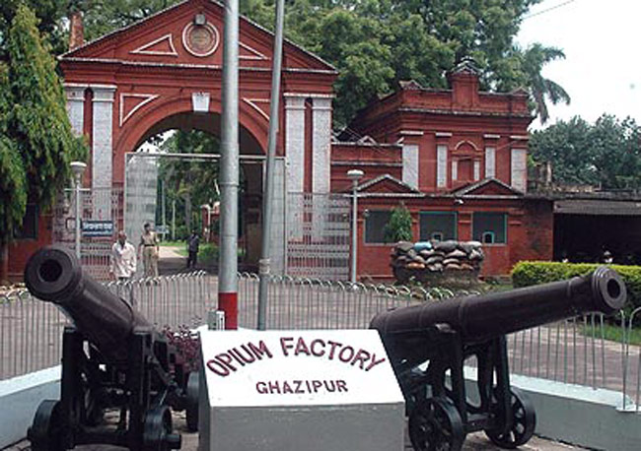
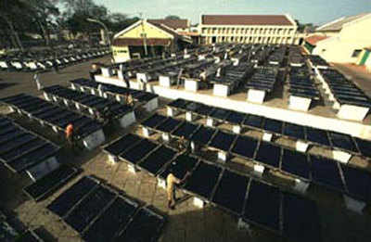
Current Status
Legal Production: India, Turkey and Australia
India: authorized by United Nations Single Convention on Narcotic Drugs to produce gum opium.
Neemuch opium factory
Source: https://smedia2.intoday.in/aajtak/images/stories/032015/government-opium-factory-ghazipur_s_650_030115091908.jpg
Sources: https://timesofindia.indiatimes.com/thumb/msid-50707742,width-400,resizemode-4/50707742.jpg

Slide 5
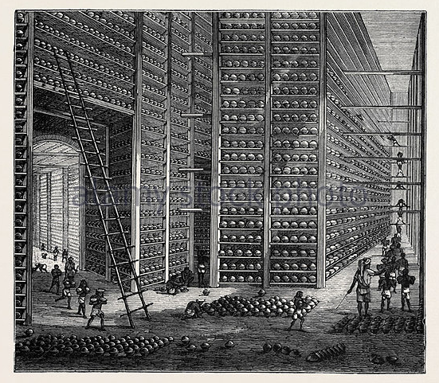
OPIUM TRADE
Trade deficit
Started in mid 1700s
Between China and Britain(through India)
Source: http://www.peachridgeglass.com/wp-content/uploads/2013/02/MassiveOpiumWarehouse.jpg

Slide 6
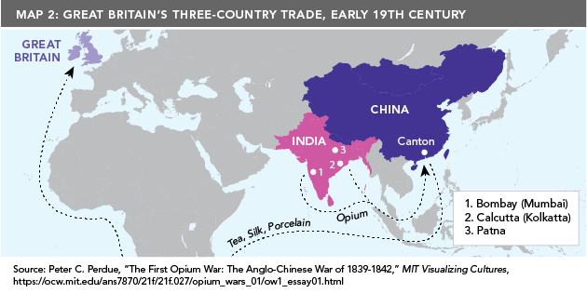
OPIUM TRADE
Source: https://asiapacificcurriculum.ca/sites/default/files/inline-images/opium-war-map2-web.png

Slide 7
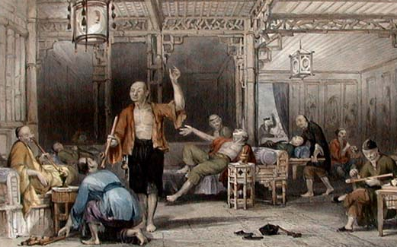
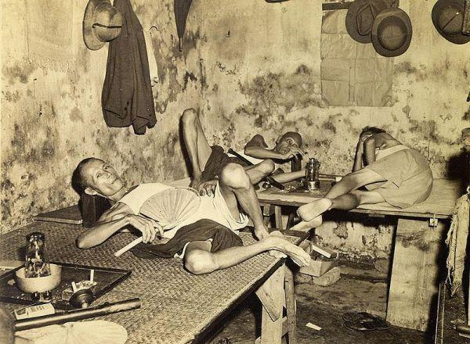
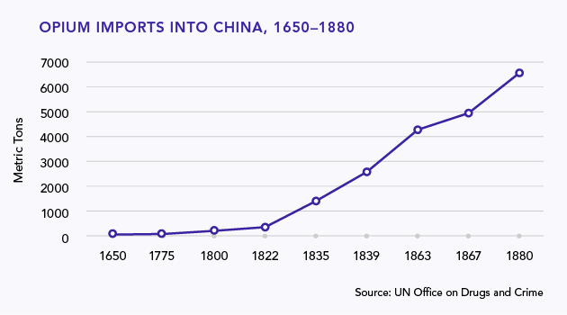
Source: http://4.bp.blogspot.com/-D9_inn5P35g/TpdbdsUEB7I/AAAAAAAAOek/-qZNxaJYZM8/s1600/AllomOpiumSmokers+ILLUSTRATED+by+Thomas+Allom+%25281804-1872%2529.jpg
Source: https://www.urbanghostsmedia.com/wp-content/uploads/2013/05/opium-smoking-den-calcutta.jpg

Slide 8
RESISTANCE
Reverse of outflow of silver
Corruption and widespread addiction
Illegal import of opium
Lin Zexu appointed

Slide 9
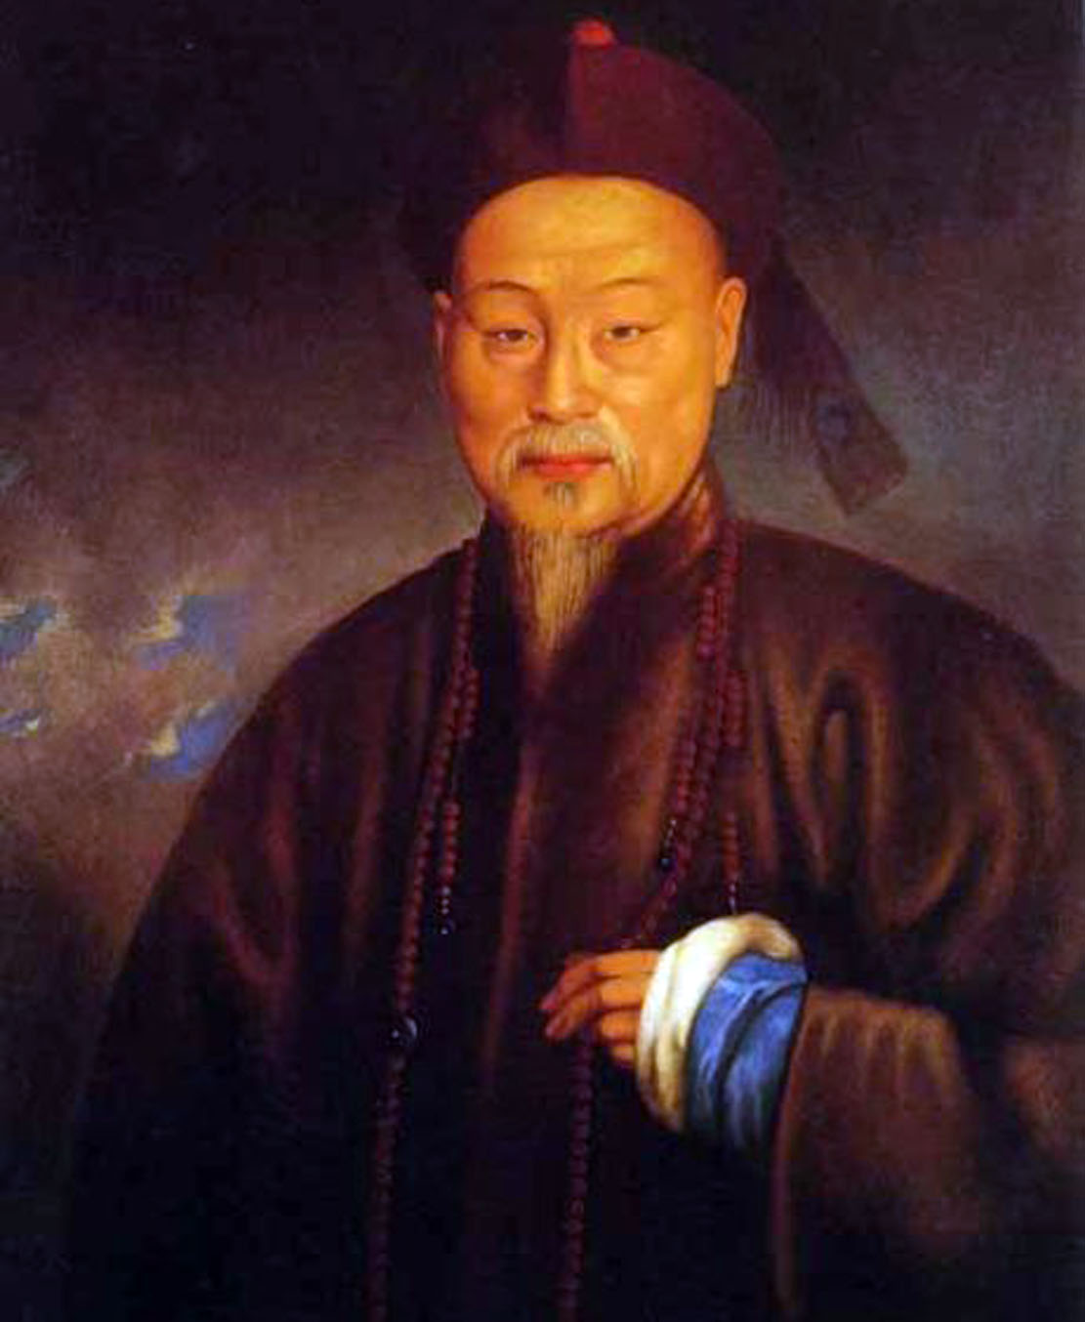
LIN ZEXU- Scholar Official
Source: https://upload.wikimedia.org/wikipedia/commons/f/f9/Lin_Zexu_1.jpg

Slide 10
FIRST OPIUM WAR
1839-1842
British underwent huge loss
China: military and politically backward

Slide 11
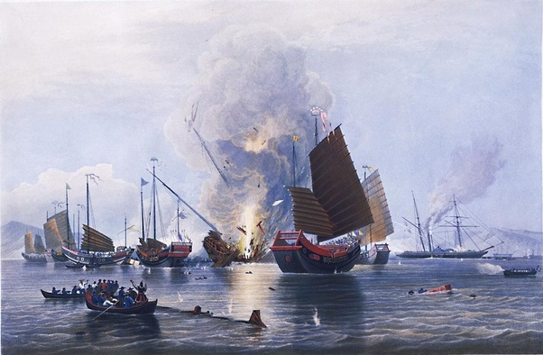
Source: http://3.bp.blogspot.com/-9l5PIbYKO_o/T-tIyEhbT9I/AAAAAAAAAV0/Q7svHij86DQ/s1600/First+Opium+War.jpg

Slide 12
UNEQUAL TREATIES
1st: Treaty of Nanjing/ Nanking
Opened China to foreign trade
Legalization of opium
Five treaty ports: Canton, Shanghai, Xiamen, Ningbo and Fuzhou
China : Parliamentary System

Slide 13
CONCLUSION
The Business boom- converted into devastating war
Had effects on both the countries:
BRITAIN: many benefits
CHINA: important lesson- never weak again

Slide 14


